Slide 1
CSI 422 (A): Computer Graphics Laboratory
Students Name
Bimurta Bismoy Sanchi
ID : 011151285
2. Shahinur Islam
ID : 011151146

Slide 2
Project name
Text art to pixel image conversion

Slide 3
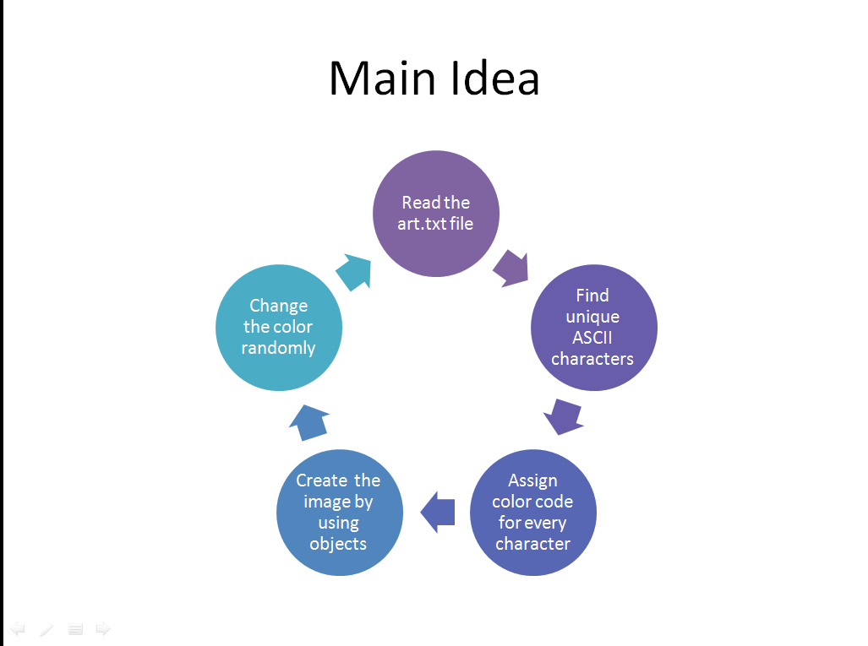
Main Idea
Read the art.txt file
Find unique ASCII characters
Assign color code for every character
Create the image by using objects
Change the color randomly

Slide 4
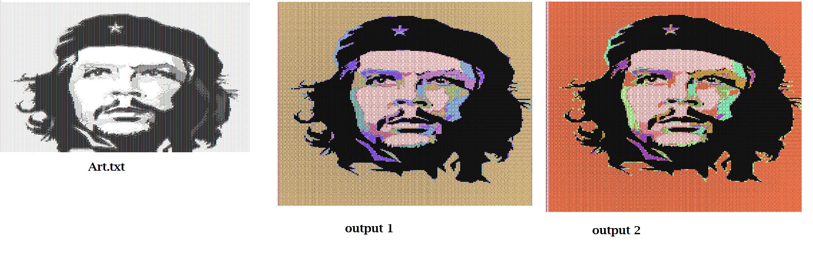
Output

Slide 5
Let’s make gif

Slide 6
External Software
http://picascii.com/
https://vectormagic.com/

Slide 7


